Slide 1
Singing Computer
A good way to manage server systems
Yu Fu

Slide 2
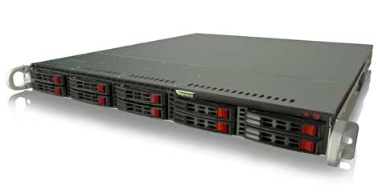
Server
a running instance of an application (software) capable of accepting requests from the client and giving responses accordingly.
http://www.datacenterknowledge.com/wp-content/uploads/2013/07/Lopoco-Server.jpg

Slide 3




Companies
Google.com; Facebook.com; Github.com; amazon.com
Amazon
Facebook
Google
gitHub
etc

Slide 4
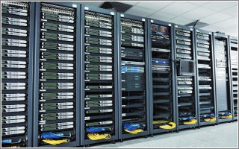
Servers
Save lots of data
Need large space
http://cdn2.istockanalyst.com/images/articles/server_room.jpg

Slide 5
How many servers at GitHub?
GitHub currently have 33 physical servers at Rackspace: 2 database (mysql, redis)
6 frontend (rails, resque)
18 file server (9 pairs: masters serve git data, slaves run memcache)
2 search
3 xen (load balancer, ci, pages, service hooks, etc)
2 staging

Slide 6
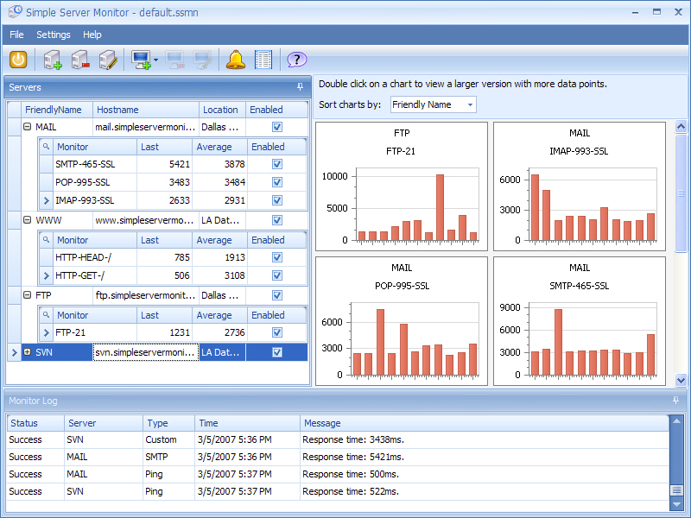
Problems
http://www.simpleservermonitor.com/images/SimpleServerMonitor.jpg
How to save data
How to monitor servers

Slide 7
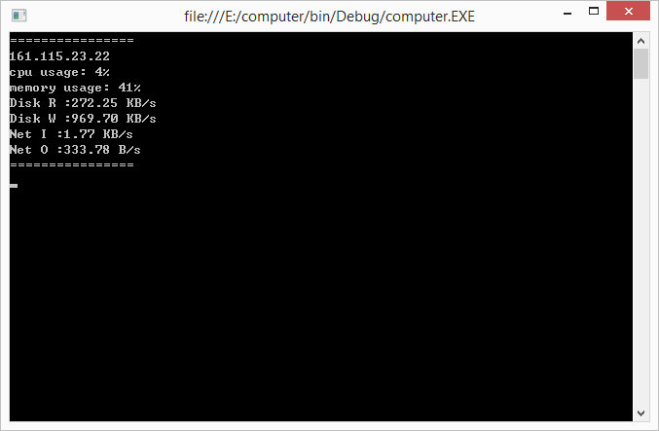
Singing Computer
Get data from every servers
IP address
CPU usage
Memory usage
Disk speed
Net speed

Slide 8
PC
Performance Counters
C# library
Counters are used to provide information as to how well the operating system or an application, service, or driver is performing.
The operating system, network, and devices provide counter data

Slide 9
MIDI
Easy access to MIDI input and output devices.
Register input handlers using C# events / delegates.
Full support for sending and receiving Note On, Note Off, Control Change, Program Change, and Pitch Bend messages.
Convenient enums for General MIDI Channels, Pitches, Instruments, Controls, and Percussions.

Slide 10
Thanks
Dr. Joe Meehean
Dr. Randy Ribler

Slide 11
Reference
http://www.quora.com/How-many-physical-virtual-servers-does-GitHub-have
Midi-dot-net

